Slide 1
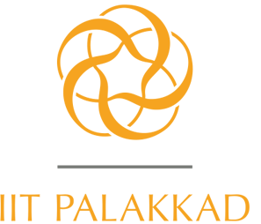
Campus Sustainability Challenge
Presented by : Abhishek Saran, Kanwar Navjot Singh, Monarch Mech

Slide 2
Outline
Problem statement
Introduction
Statistics
Solution
Data analysis and Machine learning
Effective consumption methods
References

Slide 3


Problem statement
The goal of our project is to analyze Shakthi Kitchen’s mess food wastage at IIT Palakkad and try to find efficient methods to control food waste.

Slide 4
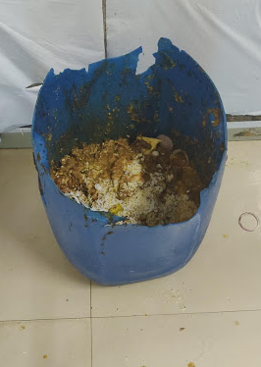
Introduction
European Union
In the European Union food waste was defined as "any food substance, raw or cooked, which is discarded, or intended or required to be discarded"
INDIANS waste as much food as the whole of United Kingdom consumes
Every year 10 million people die of hunger in India

Slide 5
Introduction
No. of people served in IIT Palakkad Mess : 537(students) + 50(faculty/staff)
Wastage per day : 70-90 Kgs(approx.)
Wastage per month : 2400 Kgs(approx.)
On an average a person consumes about 1.5 Kgs of food in a day,
therefore 1600 people could have been fed every month

Slide 6
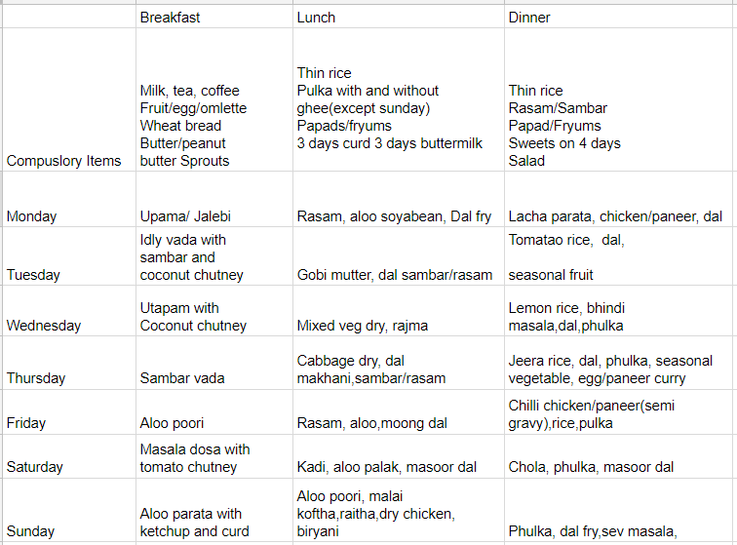
Introduction

Slide 7
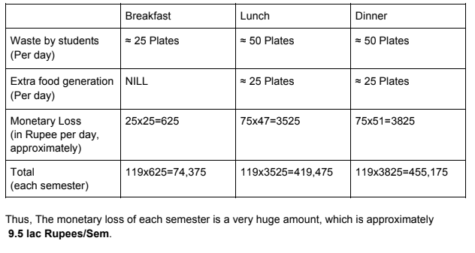
Monetary Analysis

Slide 8
Solution
Data analysis and Machine learning
Wastage Prediction and Analysis
Attendance Prediction
Dishes Analysis
Effective consumption method

Slide 9
About data and Process used
Data contained
Wastage
Meals served
Attendance
Indian cookery magazines
All codes were written in Python 3

Slide 10
Wastage: Prediction
Prediction of wastage taking features as-
Temperature
Humidity
Attendance
Weekday
Is_exam
No of examinees
Is_bakery
is_weekend

Slide 11
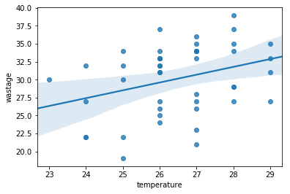
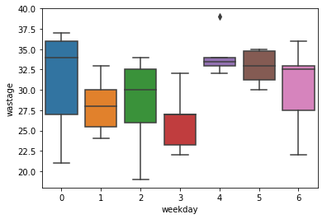
Wastage: Analysis (dinner)

Slide 12
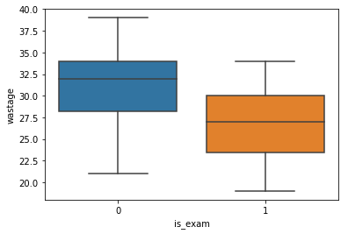
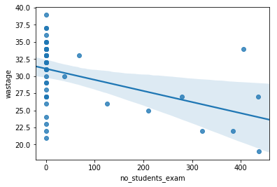
Wastage: Analysis (dinner)

Slide 13
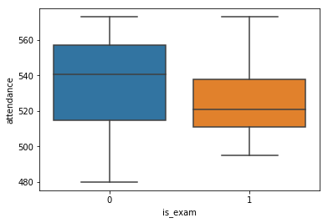
Attendance: Prediction
Feature Used-
Temperature
Humidity
Attendance
Weekdays
Exam days
No of examinees
Weekends
Bakery

Slide 14
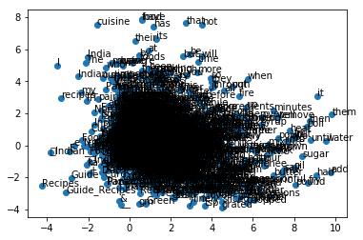
Dishes : Analysis
Libraries used:
gensim(word2vec)
gensim(phraseDetection)
rezex(preprocessing)
skylearn(PCA)

Slide 15
Dishes : Analysis
APPLICATIONS:
To find better replacement of a dish
Ex- print(model.wv.similarity("gobi", "aloo"))=0.93843
print(model.wv.similarity("gobi", "bhindi"))=0.43185
To find similarities between two dishes
Ex- model.wv.most_similar(positive=”vada”)
[(u'khichadi', 0.9138088226318359),
(u'pohe', 0.9032250642776489)]
To get better menu
Ex-

Slide 16
Python Codes
Wastage Prediction and Analysis
Attendance Prediction
Word2Vec

Slide 17
Effective consumption method
Plate Size Optimization
Tweak effects of
Lightning
Aroma
Music

Slide 18
References
Peng, M., 2017. How does plate size affect estimated satiation and intake for individuals in normal‐weight and overweight groups?. Obesity science & practice, 3(3), pp.282-288.
Ayaz, A., Akyol, A., Cetin, C. and Besler, H.T., 2016. Effect of plate size on meal energy intake in normal weight women. Nutrition research and practice, 10(5), pp.524-529.
Shimpo, M. and Akamatsu, R., 2018. The effects of bowl size and portion size on food intake and fullness ratings in a sample of Japanese men. Public health nutrition, pp.1-7.
Stroebele, N. and De Castro, J.M., 2004. Effect of ambience on food intake and food choice. Nutrition, 20(9), pp.821-838.
https://thecsrjournal.in/food-wastage-in-india-a-serious-concern/
https://blogs.mathworks.com/headlines/2017/03/28/using-data-analytics-to-reduce-food-waste/

Slide 19
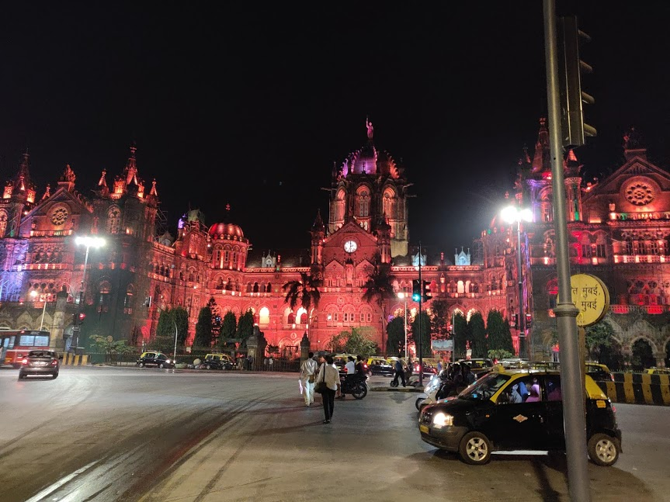
Thank You
B
O
M
B
A
Y

